Slide 1



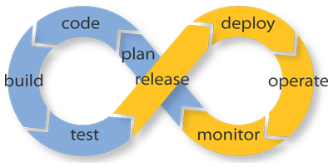
Software Testing Lifecycle
Exit Criteria Evaluation, Continuous Integration
QA
Fundamentals
Ivan Yonkov
Training Lead
Software University
http://softuni.bg

Slide 2

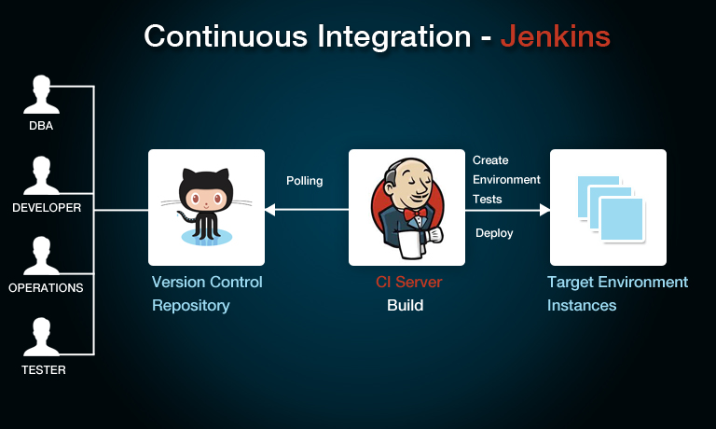
Table of Contents
What is STLC?
Exit Evaluation Criteria
Continuous integration

Slide 3
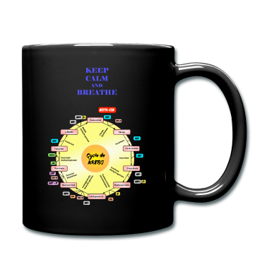
Testing Life Cycle

Slide 4
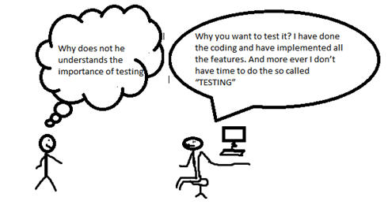
Introduction STLC

Slide 5
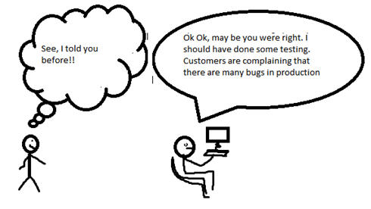
Introduction STLC (2)

Slide 6
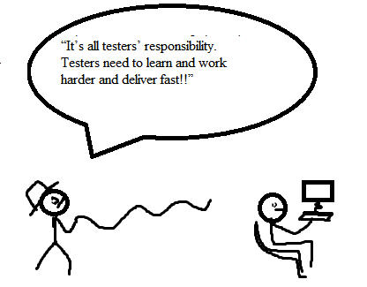
Introduction STLC (3)

Slide 7

Introduction STLC (4)
The phases of Software Testing Life Cycle
  Requirement
  Planning
  Analysis
  Design
  Implementation
  Execution
  Conclusion
  Closure

Slide 8
Introduction STLC (5)
Conclusion phase
  Includes the reporting stage
  Depends on whom you are reporting, different kind of reports are provided
Closure phase
  Check for completion of the test.
  Do lesson learnt meeting and documents

Slide 9

Continuous Integration

Slide 10
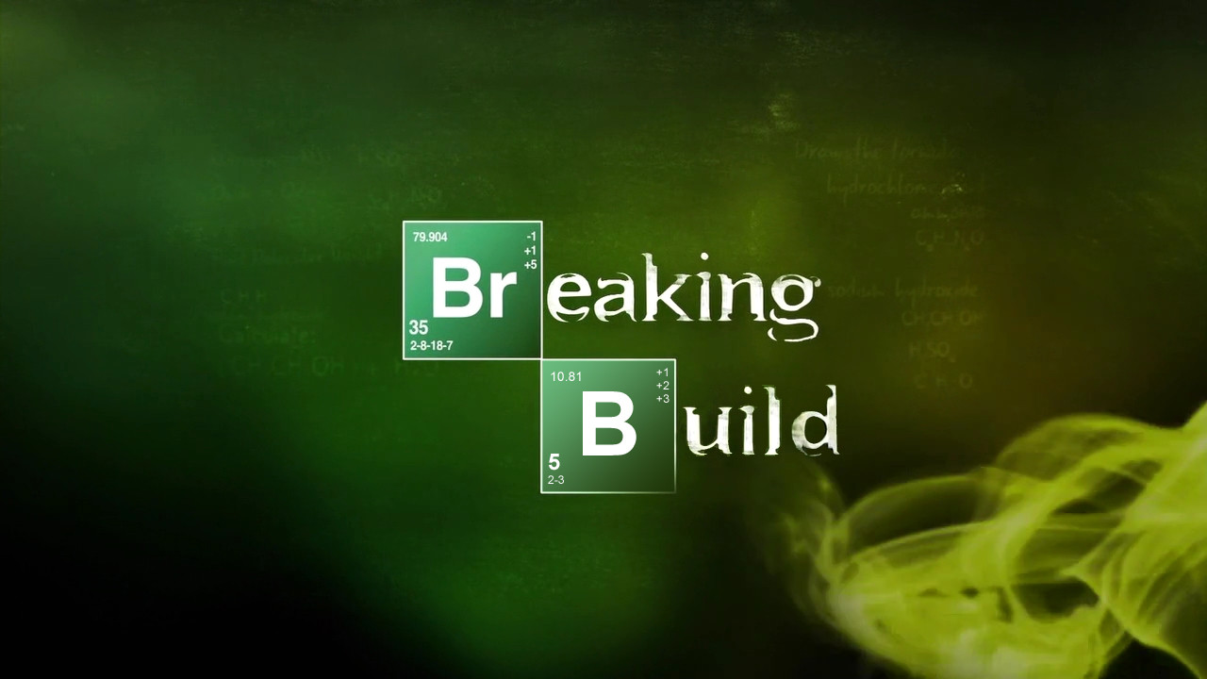
Continuous Integration
A practice of merging all developers’ working copies with a shared mainline
Its due for about 25 years and evolved to an automated process ensuring the “clean build” concept
  Commit triggers
  Unit tests
  Integration tests
  Building the source

Slide 11








Software Testing Lifecycle
http://softuni.org/courses

Slide 12
License
This course (slides, examples, demos, videos, homework, etc.)
is licensed under the "Creative Commons Attribution-NonCommercial-ShareAlike 4.0 International" license
Attribution: this work may contain portions from
  "Fundamentals of Computer Programming with C#" book by Svetlin Nakov & Co. under CC-BY-SA license
  "C# Part I" course by Telerik Academy under CC-BY-NC-SA license

Slide 13





Free Trainings @ Software University
Software University Foundation – softuni.org
Software University – High-Quality Education, Profession and Job for Software Developers
  softuni.bg
  Software University @ Facebook
  facebook.com/SoftwareUniversity
  Software University @ YouTube
  youtube.com/SoftwareUniversity
  Software University Forums – forum.softuni.bg

